Slide 1
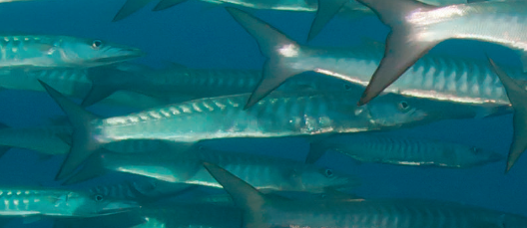
Chapter 5: Population dynamics

Slide 2
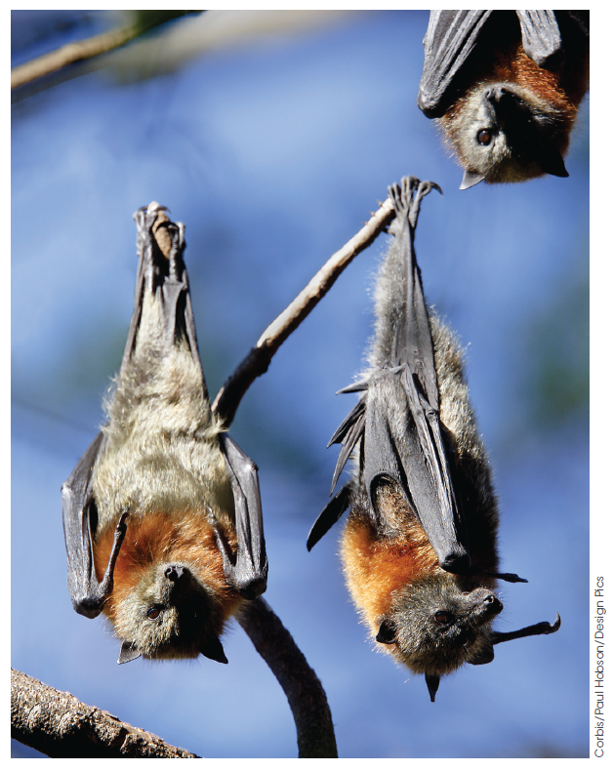
What is a population?
A population is a group of individuals belonging to the same species living in a particular area at the same time.
Figure 5.1
The grey-headed flying fox, Pteropus poliocephalus
Notes:
Populations are defined as members of a species in one place at one time.
Knowing the figures helps scientists and ecologists understand the habits and needs of organisms.
This enables humans to sustain and ensure that vulnerable species persist and contribute to the planet’s biodiversity.

Slide 3
What is a population?
Populations in unstable environments
r-selected species are early colonisers in
disturbed environments.
As they fill the previously open spaces, they change the abiotic and biotic conditions of the environment and are soon overtaken by competitors.
Notes:
In unstable, unpredictable ecosystems, such as after a fire or land-clearing, opportunistic species move in and colonise as quickly as they are able. Picture an abandoned block of land – grasses and weed species quickly take hold. In these environmental conditions population explosions of these colonisers follows. This pattern of rapid increase then decline (or crash) is called r-selection, where the maximum reproductive potential of the species is reached. In order to survive, these so-called r-selected species must colonise new environments quickly, and be able to reproduce rapidly and in relatively large numbers. As a result, they are characterised by smaller size, short life cycles and a lack of parental care for
young (in animals). Examples of r-selected species include mice, rats, frogs, toads, weeds and oysters.
Unfortunately, as the environmental resources are diminished the numbers will drop off just as rapidly as they began and these species are replaced with competitors. Locusts and other swarming insects are an example of r-selected species.

Slide 4
What is a population?
Populations in stable environments
K-selected species
Larger, longer-lived species dominate
Fewer offspring
Outcompete r-selected species
Close to carrying capacity of environment
Notes:
Larger, longer-lived species like elephants, whales, gorillas, oak trees or eucalypts outcompete the smaller, faster growing species over time. They have a more controlled population growth pattern. They can exist close to the carrying capacity of their environment. The carrying capacity describes the maximum population size of a species that can be supported in a given environment. K-selected species live longer, breed later in life, have fewer offspring and devote their lives to ensuring the survival of the offspring to reproductive maturity.

Slide 5
Growth of populations
Measuring populations
Open ecosystem: migration occurs freely
in response to environmental changes
Closed ecosystem: migration does not occur, but births and deaths still impact population size
Pop growth rate = (birth rate + immigration rate) - (death rate + emigration rate)
= (br + ir) - (dr + er)
Notes:
An open ecosystem is one where migration between populations of animals (and occasionally plants) can occur. This migration will affect overall numbers in the ecosystems involved, their distribution, and, in the longer term, birth and death rates.
A closed ecosystem is one where migration does not impact at all on population size. A population is therefore increasing if the birth rate and/or immigration rate exceeds the death rate and/or emigration rate. Rate refers to the number of individuals over time.
Alternately, a population decreases when the death and emigration rates exceed birth and immigration rates.

Slide 6
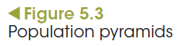
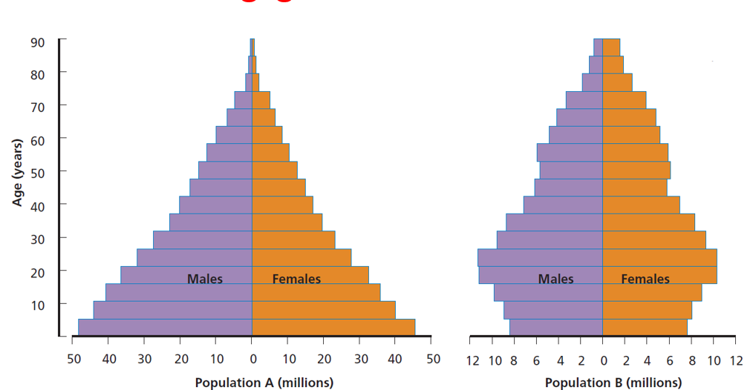
Determining growth
Measuring populations
Notes:
A useful method of representing collected data is the construction of population pyramids. Figure 5.3 shows population pyramids for two different human populations. You can see that the pyramid for population A is wider at the bottom indicating a healthy future reproduction rate, with the number of children quite high. Population A has a greater proportion of children than does population B. What is the significance of this?
Scientific data about age distribution and sex ratios can assist in the management of populations. Each year federal, state and local governments collect and collate information on the state of wild fish stocks. It is this information that is used to determine the level of both recreational and commercial sustainable fishing. Sustainability ensures that over-fishing does not drain the stocks, and that young (smaller) fish are able to contribute to the populations in the future. This information can be used to plan how to ensure sufficient numbers of young live to reach reproductive age, how to develop strategies for protecting endangered species and maintaining ecosystems, and how to restore degraded ones.

Slide 7
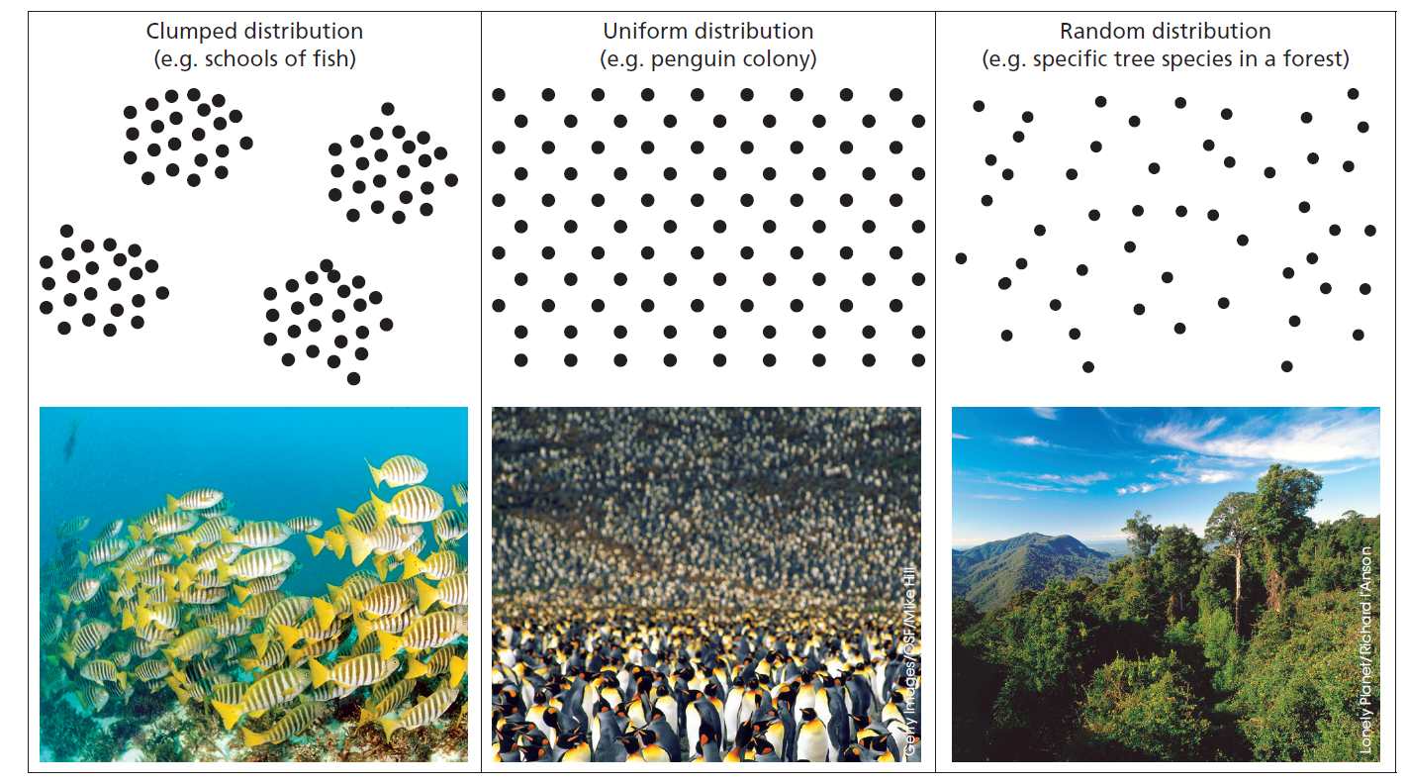
Measuring distribution
Measuring populations
Figure 5.4 Distribution patterns: clumped, uniform and random
Notes:
Members of a population are seldom spread evenly throughout the entire ecosystem. There are patterns in the way populations are distributed.
• Clumped (grouped) distribution: a number of individuals is grouped together and the groups make up the population as a whole. This is sometimes to do with social behaviour as in schools of fish, or clumping of vegetation in mini-habitats where biotic and/or abiotic factors are favourable.
• Uniform (continuous) distribution: organisms are evenly spaced; the presence of one organism determines how close or distant another will be. It is common in relatively high-density populations of some animals that set up breeding territories.
• Random distribution: organisms are spaced irregularly; the location of an organism does not affect the location of another (more common for plants than for animals).

Slide 8
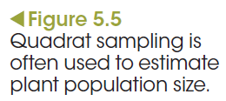
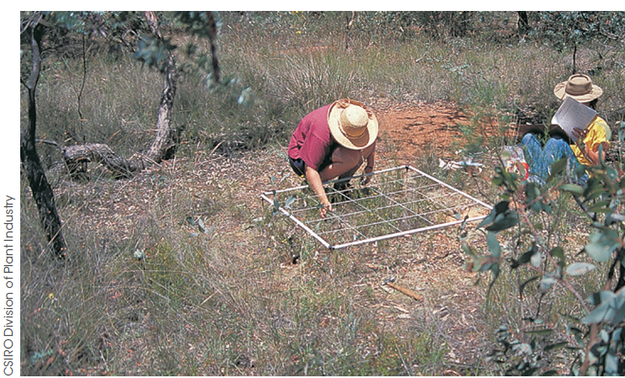
Measuring abundance
Measuring populations
Direct observation
Direct observation involves:
Sighting, or
Counting, or
sampling a population
Quadrats
For each quadrat:
the number of individuals of each species is counted and recorded, or
• the relative numbers of each species is estimated using a scale from abundant (3) to absent (0), or
• percentage cover is estimated, and
• the totals of the quadrats are averaged.
Notes:
If sufficient quadrats are chosen, and they are representative of the area under study, results can be used to estimate total population size.
A simple mathematical calculation can give the total number or percentage cover for each species in the whole area. The density can also be calculated.
Estimating total population size of area under study
Average density of members of species (estimated)
= total number of individuals counted / area of each quadrat x number of quadrats

Slide 9
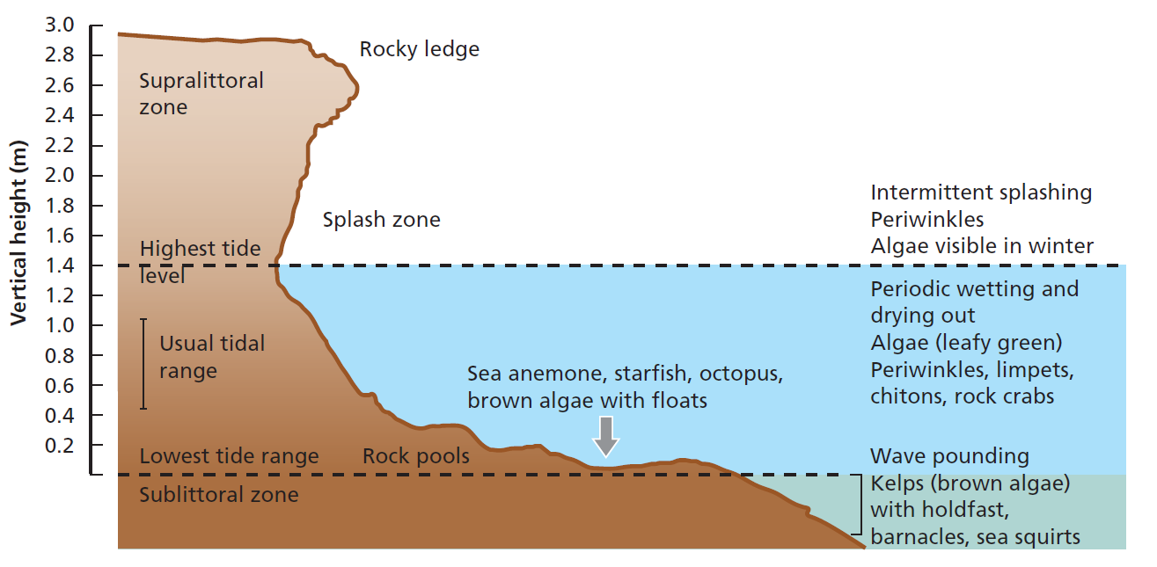
Measuring abundance
Measuring populations
Transect
A transect is a line drawn through a community and the information gathered is used to determine the distribution of species within that community.
Figure 5.6 Transect profile of a marine rock platform
Notes:
When an area has been selected for study and the data needed has been nominated, the transect line is measured out. It may be 10 m long with regular segments (every metre) where information regarding changes in distribution is recorded as one moves along a tidal zone towards land. It may also provide information on vertical features such the canopy of the forest, as well as the species present.
Data gathered using transects offers fairly accurate information regarding distribution of individuals and/or species; whereas quadrats offer a comprehensive picture of species abundance, but not distribution.

Slide 10
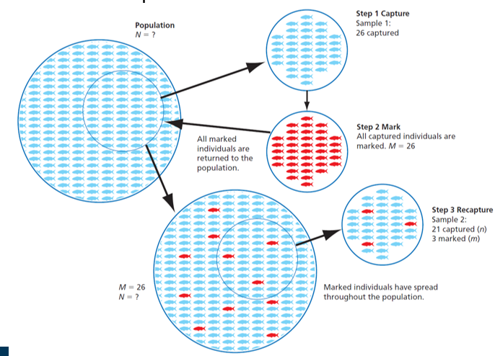
Measuring abundance
Measuring populations
Capture–mark–recapture
Capture–mark–recapture is used to sample mobile species. A random sample of individuals of a species is taken and an overall estimation of the abundance of the species is made.
Notes:
Step 1 Capture: animals are caught randomly and in such a way that they are unhurt. Small animals are trapped in cages or pitfalls in the ground, birds are trapped in fine nets and some animals are caught easily when they ‘freeze’ in spotlights. Flying insects are attracted to light traps.
Step 2 Mark: each captured animal is marked so that the mark is not obvious to predators or harmful to the organism. Insects are usually marked with a blob of paint, whereas birds are tagged on the leg or wing. The animals are returned to their habitat and left to mix with the unmarked individuals.
Step 3 Recapture: later, a random sample is taken and the number of marked individuals counted. The timing of recapture needs to be appropriate to again capture a random mixture of individuals, but without leaving it so long that many of the original marked individuals have died. From this information the total population can be estimated. The procedure has to be planned carefully so that the chances of each individual being caught are equal. Sometimes ‘trap happy’ individuals will be sampled over and over.

Slide 11
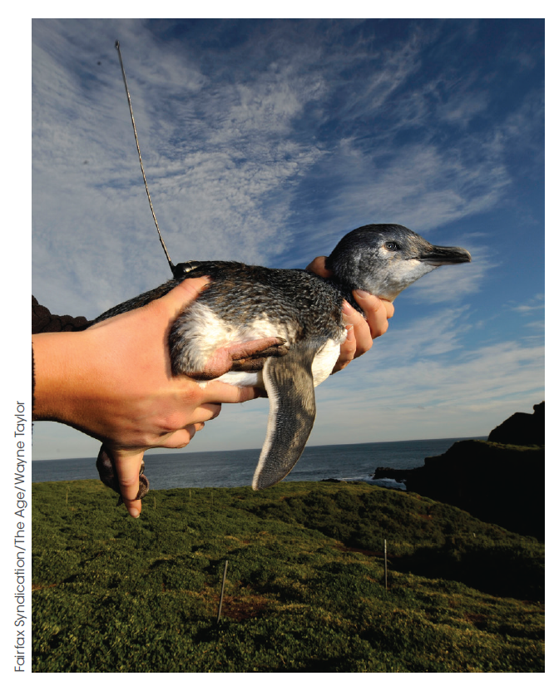
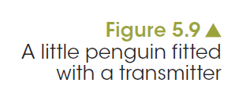
Measuring abundance
Measuring populations
Telemetry (remote tracking)
Notes:
Species distribution modelling is used to predict future needs and resource management and is a more recent technology used for conservation and management.
Little Penguins on Phillip Island fitted with GPS transmitters could be used to plot their movements as they search for food. This data helps monitor their season movements in time and space.
GPS tracking is also used to track the movements of migrating animals such as birds and caribou, and is most efficient when tracking water animals such as whales, sharks, sea turtles and many sea birds. The signal is received by a satellite which ensures the animals are tracked when not in sight.
Radio tracking is older technology than the GPS tracking systems. In this instance, the signal is transmitted from the unit attached to the animal to a receiver, much like a home transistor radio. The animals are physically followed by the scientists who will have the receiver in a car, truck or aeroplane. The data collected determines the movements of the animals and their destination. The information is then used to determine the best management strategy to ensure the safe movement of the animals involved.

Slide 12
Population density
Measuring populations
Density: the number of individuals in a given area
Carrying capacity: the maximum population size of a species that can be supported in a given environment
Knowing the density of populations can help assess an ecosystem’s ability to provide sufficient resources to support its populations.
Notes:
Studying the density of populations in an ecosystem is useful in certain situations. Density refers to the number of individuals in a given area, such as the number of kangaroos per hectare.
Sometimes it is difficult to distinguish individual plants, as with grass. In that case, density is the amount of biomass (dry) per unit area (e.g. 0.6 kg of grass per m²). In the case of diatoms in a pond it is the number per unit volume, for example 300/mL.

Slide 13
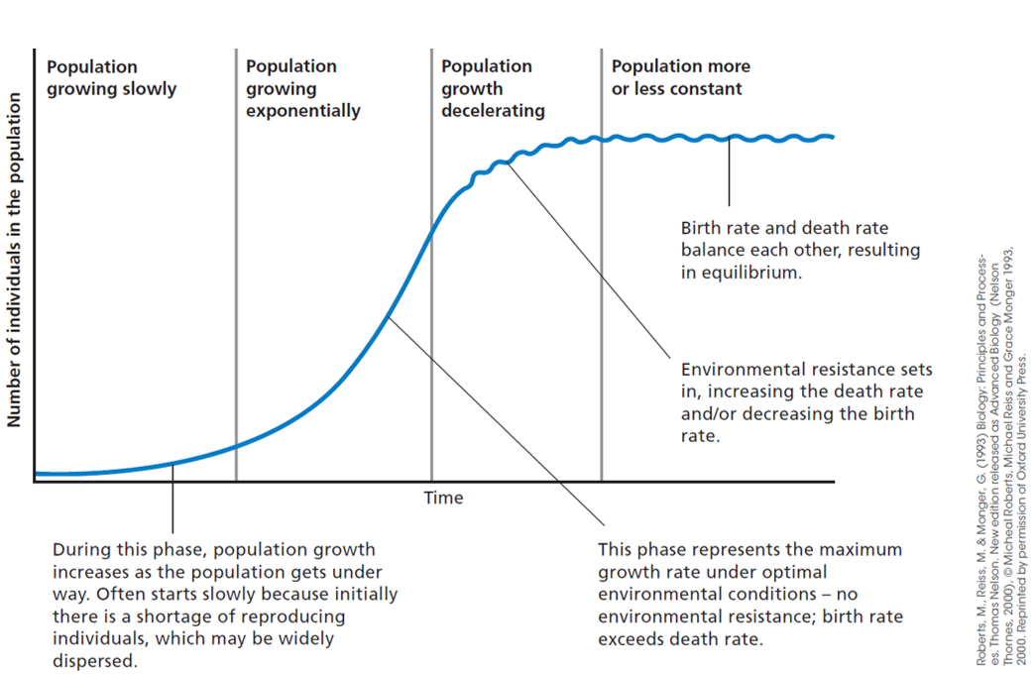
Population growth
Population regulation
Notes:
Factors in the environment, collectively referred to as environmental resistance, act on a population. If the population rises above the equilibrium or set point, competition for resources such as food and space begins to take effect. The increased ability of disease-causing organisms and parasites to spread also increases deaths and possibly reduces breeding. This could be to such an extent that the population falls. If it falls below the set point, there is less competition and the population begins to rise again. This kind of negative feedback process, or homeostatic control, keeps the population more or less constant (Figure 5.13).
Is this scenario an example of K-selection or r-selection?

Slide 14
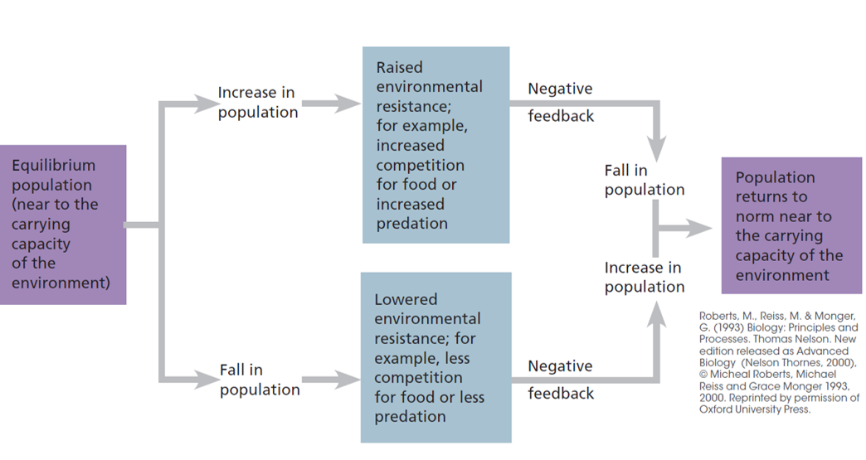
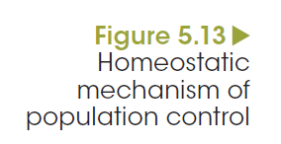
Population growth
Population regulation

Slide 15
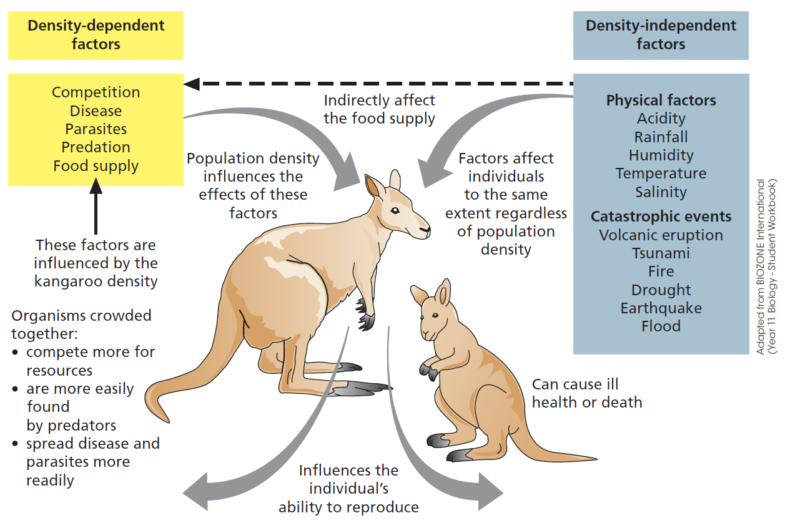
Population growth
Population regulation
Notes:
Density-dependent factors include competition, disease, parasites, predation and food supply. The greater the density of a population, the more individuals die or fail to reproduce.
Density-independent factors, such as severe weather conditions, volcanic activity or habitat destruction by clearing or fire, are those that affect all individuals in a population regardless of age or stage. These factors are seen
vividly following a catastrophic event such as a bushfire or flooding. Populations of all living things usually decrease quite drastically due to either death or emigration to a habitat that is better able to meet their needs.
In some cases, populations of species are not able to recover from such extreme environmental resistance and disappear from that ecosystem, which may eventually result in widespread extinction.

Slide 16
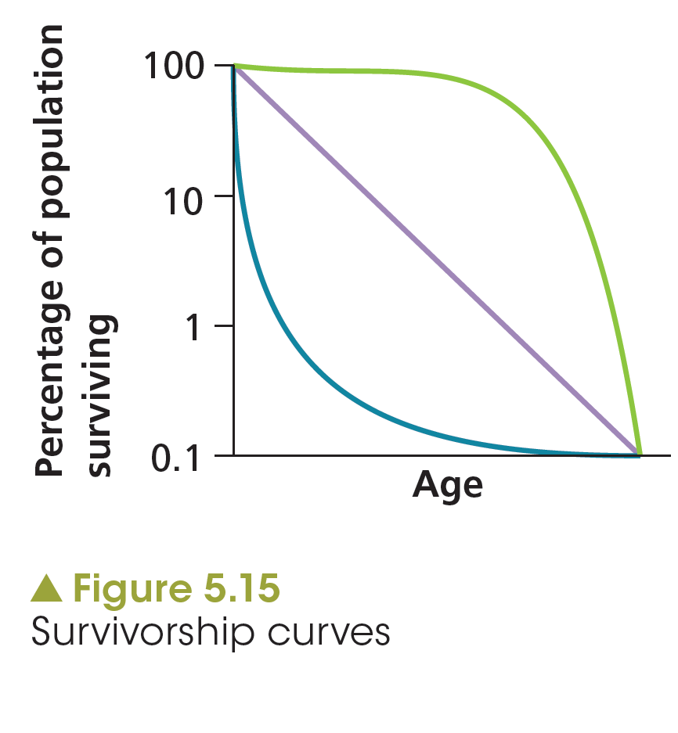
Population growth
Population regulation
Notes:
Population survival. A combination of factors, working together, determines the survival of populations.
There are patterns in survivorship of various species. Species can be classified according to their probability of survival. This can be represented in a graph.

Slide 17
Controlling populations
Restoring populations
The rate of species lost is alarming, but there are examples of species being restored through:
natural cycles of population change
careful management
legal protection of species.
Read the case study, ‘Breeding, releasing and succeeding’ on page 118
Notes:
Examine the case study, ‘Breeding, releasing and succeeding’ on page 118.
When does a living thing become a pest? Sometimes populations of species increase enormously at the expense of others when environmental conditions change. The development of particular agricultural practices, the introduction of species accidentally or deliberately and the concentration of people in urban environments have created excellent conditions for certain plants and animals to exploit.
Many fungi and insects, without natural predators, have been able to wreck havoc on crops of all kinds. Consider the mouse plagues common in Australia since European settlement or the invasive weed, Paterson’s curse, which lives up to its name.

Slide 18
Controlling populations
Restoring populations
Chemical and biological control
There are four kinds of biological control agents.
1. General predators: organisms that consume a great variety of pest species; e.g. ladybugs, target aphids, caterpillars, mites and small beetles
2. Specialised predators: organisms that target one pest species, e.g. dragonflies target all life stages of mosquitoes
3. Parasites: e.g. wasps lay their eggs in the bodies of hosts, leading to the host’s death.
4. Microbial diseases: caused by bacteria, fungi and viruses that target species and cause death.
Notes:
Scientists now favour the use of biological control agents, which exploit relationships between organisms; or an integrated approach when rapid response is needed in the early stages to manage a problem. This may also be known as integrated pest management which encourages the use of biological measures to control pests and limits the use of chemicals to narrow-spectrum agents that target specific species.

Slide 19
Controlling populations
Restoring populations
Culling
Culling ensures the:
sustainability of ecosystems
viability of native species.
Notes:
In 2013 conservationists called for the culling of the wild horse population of Victoria’s alpine areas as it threatened the health of the alpine environment. The wild horse, or brumby population, was estimated at 10 000 strong. Australian environments suffer from the effects of these hooved animals. Grasses are trampled, leading to soil erosion and the prospect of long-term rehabilitation of the area is jeopardised.

Slide 20
Reintroducing populations
Restoring populations
Invasion of pest species devastates native populations.
Native populations decline due to:
a lack of resources
a loss of habitat
predation.
Eradication of pest species; e.g. through quarantine from protected stock.
Reintroduce native species; i.e. restocking in captivity.
Notes:
One example worthy of study is the Galaxia genus. It is a native freshwater fish whose numbers have suffered since the introduction and proliferation of the Mosquito fish, which does very little to impact the mosquito numbers. Galaxia do not lay eggs; but give birth to live young that are easily devoured by the pest species. The numbers of Galaxia have dropped to such low levels that numbers in the wild are no longer self-sustaining in some areas. However, it is relatively easy to breed in captivity.
In order to re-introduce it to the wild, the Mosquito fish needs to be eradicated, or the same cycle that led to Galaxia’s decreased numbers will still exist. Eradication is a difficult process, so currently the only means of introducing Galaxia back into the wild is through the location of uninfested waterways or artificially created ponds that have no migratory possibilities with infested ponds, lakes, streams or rivers. The reduction in numbers of Galaxia has led to associated drops in the population numbers of native frogs and other aquatic species such as native insects.

